Slide 1
Accelerating Genome Sequence Analysis via Efficient Hardware/Algorithm Co-Design
Damla Senol Cali
Carnegie Mellon University
(dsenol@andrew.cmu.edu)
June 24, 2021
Job Talk
Notes:
Hello, I am Damla Senol Cali. Thank you so much for joining to my talk!
I am a 6th year Ph.D. candidate in the SAFARI Research Group @ Carnegie Mellon University
And today, I'll be discussing some of the work I have been doing during my PhD on ”Accelerating Genome Sequence Analysis via Efficient Hardware/Algorithm Co-Design".

Slide 2
Genome Sequencing
Genome sequencing: Enables us to determine the order of the DNA sequence in an organism’s genome
Plays a pivotal role in:
Personalized medicine
Outbreak tracing
Understanding of evolution
Challenges:
There is no sequencing machine that takes long DNA as an input, and gives the complete sequence as output
Sequencing machines extract small randomized fragments of the original DNA sequence
Notes:
[CLICK] Genome sequencing, which enables us to determine the DNA sequence of an organism, [CLICK] plays a pivotal role in areas such as personalized medicine, outbreak tracing (like COVID-19), and the understanding of evolution.
However, there is no …

Slide 3





Genome Sequencing (cont’d.)
Chopped DNA
fragments
Sequenced reads
Sample Collection
Sequencing
Large DNA
molecule
Preparation
Genome Sequence Analysis

Slide 4
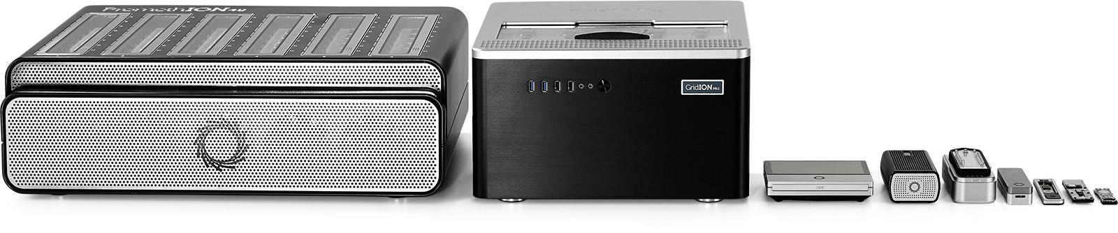
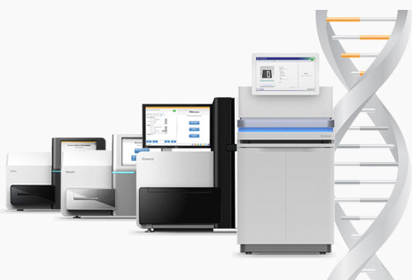
Sequencing Technologies
Oxford Nanopore (ONT)
PacBio
Illumina
Short reads: a few hundred base pairs and error rate of ∼0.1%
Long reads: thousands to millions of base pairs and error rate of 5–10%
Notes:
Based on the sequencing device, we obtain either short reads or long reads.

Slide 5
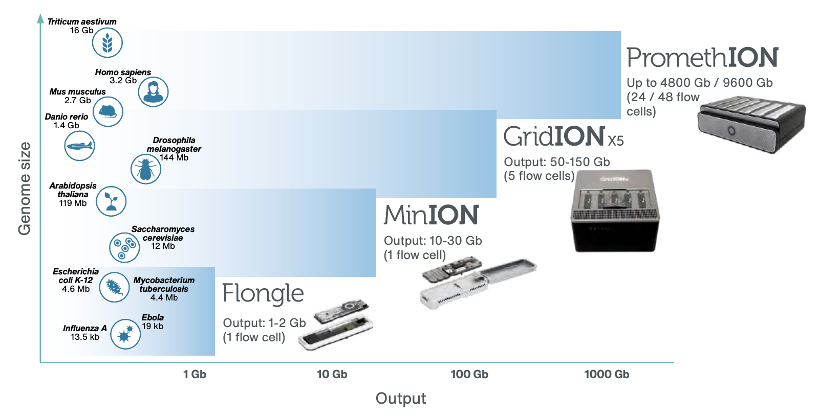
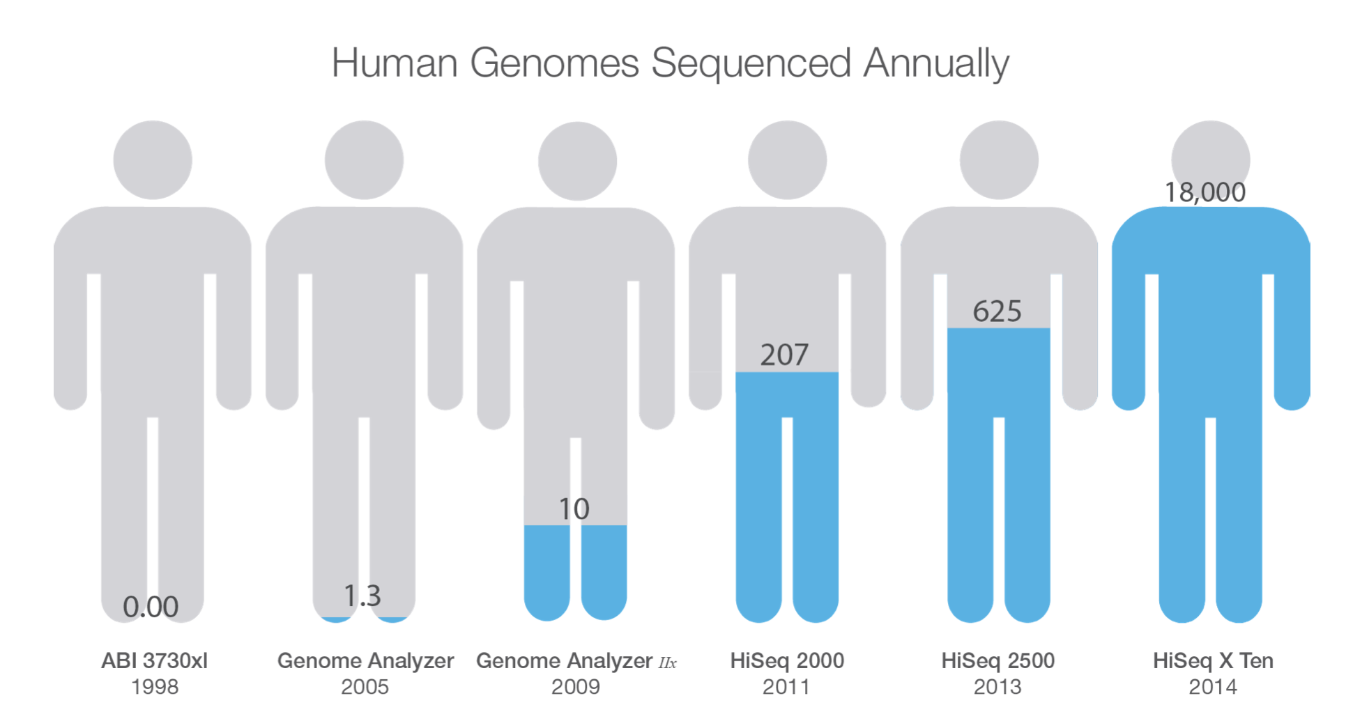
Current State of Sequencing
Notes:
As the sequencing devices become cheaper and more accessible, the amount of genomics data that is generated gets much higher.

Slide 6
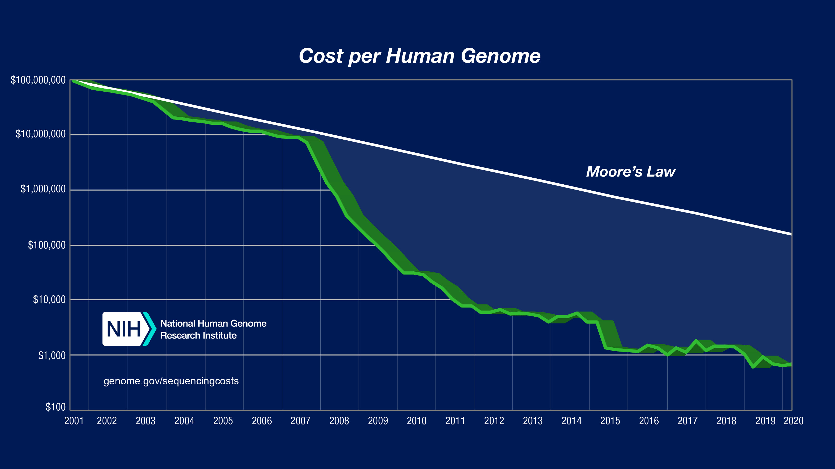
Current State of Sequencing (cont’d.)
*From NIH (https://www.genome.gov/about-genomics/fact-sheets/DNA-Sequencing-Costs-Data)
Notes:
However, the compute power doesn’t match up with this trend.
Modern sequencing machines generate read fragments at an exponentially higher rate than prior sequencing technologies, with their growth far outpacing the growth in computational power in recent years
For example, the Illumina NovaSeq 6000 system can sequence about 48 human whole genomes at 30× genome coverage (the av- erage number of times a genomic base is sequenced) in about two days. However, analyzing (performing mapping and variant calling) the sequencing data of a single human genome requires over 32 CPU hours on a 48-core Intel Xeon processor, 23 of which are spent on read mapping

Slide 7
Current State of Sequencing (cont’d.)
Computation is a bottleneck!
*From NIH (https://www.genome.gov/about-genomics/fact-sheets/DNA-Sequencing-Costs-Data)
Notes:
However, the compute power doesn’t match up with this trend.
Modern sequencing machines generate read fragments at an exponentially higher rate than prior sequencing technologies, with their growth far outpacing the growth in computational power in recent years
For example, the Illumina NovaSeq 6000 system can sequence about 48 human whole genomes at 30× genome coverage (the av- erage number of times a genomic base is sequenced) in about two days. However, analyzing (performing mapping and variant calling) the sequencing data of a single human genome requires over 32 CPU hours on a 48-core Intel Xeon processor, 23 of which are spent on read mapping

Slide 8
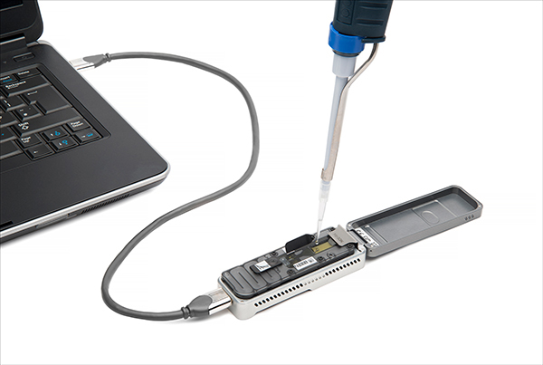

Future of Genome Sequencing & Analysis
MinION from ONT
SmidgION from ONT
Notes:
And what should we expect in near future?
Introduction of very small, portable and cheap devices that can be plugged to your mobile phones, which would enable everyone to perform sequencing on their own genome by themselves using their mobile phones.
But challenge is, how to perform the required analysis on our phones which have even more limited resources.

Slide 9
Problem Statement
Rapid genome sequence analysis is currently bottlenecked by the computational power and memory bandwidth limitations of
existing systems, as many of the steps
in genome sequence analysis must process
a large amount of data
Notes:
However,

Slide 10
Our Goal & Approach
Our Goal:
Accelerating genome sequence analysis by efficient hardware/algorithm co-design
Our Approach:
Analyze the multiple steps and the associated tools in the genome sequence analysis pipeline,
Expose the tradeoffs between accuracy, performance, memory usage and scalability, and
Co-design fast and efficient algorithms along with scalable and energy-efficient customized hardware accelerators for the key bottleneck steps of the pipeline
Notes:
To this end, our goal is to accelerate …

Slide 11
Outline
Bottleneck analysis of long read assembly
[Briefings in Bioinformatics, 2018]
GenASM: Approximate string matching framework
for genome sequence analysis
[MICRO 2020]
BitMAc: FPGA-based near-memory acceleration of bitvector-based sequence alignment
[Ongoing]
GenGraph: Hardware acceleration framework
for sequence-to-graph mapping
[Ongoing]
Notes:
To this end, I will cover 4 of my works today.

Slide 12
Outline
Bottleneck analysis of long read assembly
[Briefings in Bioinformatics, 2018]
GenASM: Approximate string matching framework
for genome sequence analysis
[MICRO 2020]
BitMAc: FPGA-based near-memory acceleration of bitvector-based sequence alignment
[Ongoing]
GenGraph: Hardware acceleration framework
for sequence-to-graph mapping
[Ongoing]

Slide 13
Genome Sequence Analysis
ACGTACCCCGT
TTTTTTTAATT
ACGAGCGGGT
GATACACTGTG
AAAAAAAAAA
Reads
CTAGGGACCTT
ACGACGTAGCT
Read Mapping, method of aligning the reads against the reference genome in order to detect matches and variations.
De novo Assembly, method of merging the reads in order to construct the original sequence.
Reference
Genome
Original
Sequence
Reads
Mapped Reads
Reads
Assembled Reads
Notes:
When I say analysis, what do I mean. What I mean is how we will analyze these reads.
They can then be analyzed following two different approaches:
First one is Read mapping and it is the process of aligning the reads against the reference genome to detect sequencing errors and variations in the sequenced genome.
And the second approach is de novo assembly, which is the method of combining the reads to construct the original sequence when a reference genome does not exist.

Slide 14
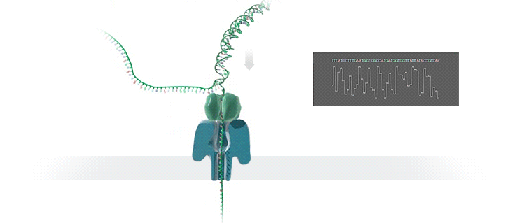
Genome Assembly Pipeline Using Long Reads
With the emergence of long read sequencing technologies, de novo assembly becomes a promising way of constructing the original genome.
Raw signal data
Basecalling
(Translates signal data into bases: A,C,G,T)
DNA reads
Read-to-Read Overlap Finding
(Finds pairwise read alignments for each pair of read)
Overlaps
Assembly
Assembly
(Traverses the overlap graph & constructs the draft assembly)
Draft assembly
Read Mapping
(Maps the reads to the draft assembly)
Mappings of reads against draft assembly
Improved assembly
Polishing
(Polishes the draft assembly & increases the accuracy)
Notes:
With the emergence of long read sequencing technologies (i.e., ONT and PacBio), de novo assembly becomes a promising way of constructing the original genome since a long read can span an entire repetitive sequence and enable continuous and complete assemblies.
The output of nanopore sequencers is raw signal data that represents changes in electric current when a DNA strand passes through nanopore. Thus, the pipeline starts with the raw signal data. The first step, basecalling, translates this raw signal output of MinION into bases (A, C, G, T) to generate DNA reads. It is important to note that basecalling is the only step unique to nanopore sequencing, and the rest of the steps are applicable for both of the long read sequencing technologies (ONT and PacBio).
The second step computes all pairwise read alignments between each pair of reads, called read-to-read overlaps. The third pipeline step, genome assembly, generates an overlap graph, where each node denotes a read and each edge represents the overlaps between the corresponding two nodes. Then it traverses this overlap graph, produces the layout of the reads and then constructs a draft assembly. To increase the accuracy of the assembly, further polishing, i.e., post-assembly error correction, may be required, but it is optional. The fourth step of the pipeline is mapping the original basecalled reads to the generated draft assembly from the previous step (i.e., read mapping). The fifth and final step of the pipeline is polishing the assembly with the help of mappings from the previous step.

Slide 15
Our Contributions
Analyze the tools in multiple dimensions: accuracy, performance, memory usage, and scalability
Reveal new bottlenecks and trade-offs
First study on bottleneck analysis of nanopore sequence analysis pipeline on real machines
Provide guidelines for practitioners
Provide guidelines for tool developers
Notes:
In this work, we analyze the tools associated with the multiple steps in the genome assembly pipeline using nanopore sequence data in terms of accuracy, speed, memory efficiency and scalability.
Reveal bottlenecks and trade-offs that different combinations of tools and different underlying systems lead to
This is the first study on bottleneck analysis of nanopore sequence analysis pipeline on real machines
Provide guidelines for practitioners, such that they can determine the appropriate tools and tool combinations that can satisfy their goals, and
Provide guidelines for tool developers, such that they can make design choices to improve current and future tools.

Slide 16
Experimental Methodology
Notes:
In this work, for accuracy and performance evaluations of different tools, we use three separate systems with different specifications.
We choose the first system for obtaining the outputs of each step and preforming accuracy analysis, as it has a larger memory capacity than a usual server, and with the help of a large number of cores, the tasks can be parallelized easily to get the output data quickly.
We choose the second system, called desktop, as it represents a commonly used desktop server.
We choose the third system, called big-mem, because of its large memory capacity and high number of cores. It represent the opposite of the desktop server.

Slide 17
Experimental Methodology (cont’d.)
Accuracy Metrics
Average Identity : Percentage similarity between the assembly and the reference genome
Coverage: Ratio of the #aligned bases in the reference genome to the length of reference genome
Number of mismatches: Total number of single-base differences between the assembly and the reference genome
Number of indels: Total number of insertions and deletions between the assembly and the reference genome
Performance Metrics
Wall clock time
Peak memory usage
Parallel speedup
Using /usr/bin/time & perf
Notes:
We compare each draft assembly generated after the assembly step and each improved assembly generated after the polishing step with the reference genome.
By coverage, I mean the length of the reference genome covered by the assembled genome.
By identity, I mean the percentage of number of matches between the reference genome and assembled genome.
We analyze the performance of each tool by running the associated command-line of each tool with the /usr/bin/time and also with perf.

Slide 18
Key Findings
Laptops are becoming a popular platform for running genome assembly tools, as the portability of a laptop makes it a good fit for in-field analysis
Greater memory constraints
Lower computational power
Limited battery life
Memory usage is an important factor that greatly affects the performance and the usability of the tool
Data structure choices that increase the memory requirements
Algorithms that are not cache-efficient
Not keeping memory usage in check with the number of threads
Scalability of the tool with the number of cores is an important requirement. However, parallelizing the tool can increase the memory usage
Not dividing the input data into batches
Not limiting the memory usage of each thread
Dividing the dataset instead of the computation between simultaneous threads
Notes:
We have 21 observations in our paper, but let me highlight 3 key findings we made
Laptops are becoming a popular platform for running genome assembly tools, as the portability of a laptop makes it a good fit for in-field analysis
Greater memory constraints,
Lower computational power, and
Limited battery life
Memory usage is an important factor that greatly affects the performance and the usability of the tool
Data structure choices that can minimize the memory requirements
Cache-efficient algorithms
Keeping memory usage in check with the number of threads
Scalability of the tool with the number of cores/threads is an important requirement.
However, parallelizing the tool can increase the memory usage.
Dividing the input data into batches
Limiting the memory usage of each thread
Dividing the computation instead of the dataset between simultaneous threads

Slide 19
Key Findings
Goal 1:
High-performance and low-power
Laptops are becoming a popular platform for running genome assembly tools, as the portability of a laptop makes it a good fit for in-field analysis
Greater memory constraints,
Lower computational power
Limited battery life
Memory usage is an important factor that greatly affects the performance and the usability of the tool
Data structure choices that increase the memory requirements
Algorithms that are not cache-efficient
Not keeping memory usage in check with the number of threads
Scalability of the tool with the number of cores is an important requirement. However, parallelizing the tool can increase the memory usage
Not dividing the input data into batches
Not limiting the memory usage of each thread
Dividing the dataset instead of the computation between simultaneous threads

Slide 20
Key Findings
Goal 1:
High-performance and low-power
Laptops are becoming a popular platform for running genome assembly tools, as the portability of a laptop makes it a good fit for in-field analysis
Greater memory constraints,
Lower computational power
Limited battery life
Memory usage is an important factor that greatly affects the performance and the usability of the tool
Data structure choices that can minimize the memory requirements
Cache-efficient algorithms
Keeping memory usage in check with the number of threads
Scalability of the tool with the number of cores is an important requirement. However, parallelizing the tool can increase the memory usage
Not dividing the input data into batches
Not limiting the memory usage of each thread
Dividing the dataset instead of the computation between simultaneous threads
Goal 2:
Memory-efficient

Slide 21
Key Findings
Goal 1:
High-performance and low-power
Laptops are becoming a popular platform for running genome assembly tools, as the portability of a laptop makes it a good fit for in-field analysis
Greater memory constraints,
Lower computational power
Limited battery life
Memory usage is an important factor that greatly affects the performance and the usability of the tool
Data structure choices that can minimize the memory requirements
Cache-efficient algorithms
Keeping memory usage in check with the number of threads
Scalability of the tool with the number of cores is an important requirement. However, parallelizing the tool can increase the memory usage.
Dividing the input data into batches
Limiting the memory usage of each thread
Dividing the computation instead of the dataset between simultaneous threads
Goal 2:
Memory-efficient
Goal 3:
Scalable/highly-parallel

Slide 22
Outline
Bottleneck analysis of long read assembly
[Briefings in Bioinformatics, 2018]
GenASM: Approximate string matching framework
for genome sequence analysis
[MICRO 2020]
BitMAc: FPGA-based near-memory acceleration of bitvector-based sequence alignment
[Ongoing]
GenGraph: Hardware acceleration framework
for sequence-to-graph mapping
[Ongoing]
Notes:
to meet the goals that we discussed, we need to co-design the HW and SW

Slide 23
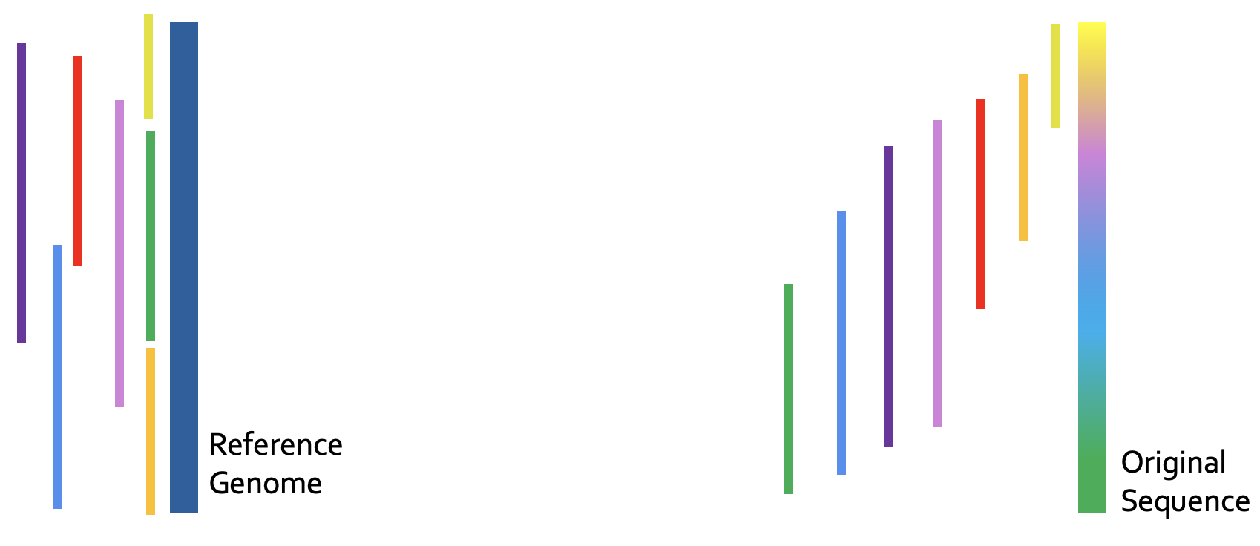
Recall: Genome Sequence Analysis
ACGTACCCCGT
TTTTTTTAATT
ACGAGCGGGT
GATACACTGTG
AAAAAAAAAA
Reads
CTAGGGACCTT
ACGACGTAGCT
Read Mapping, method of aligning the reads against the reference genome in order to detect matches and variations.
De novo Assembly, method of merging the reads in order to construct the original sequence.
Notes:
As I mentioned, read mapping is one of the steps of the assembly pipeline.
However, if you remember, read mapping is also another main approach to perform GSA. And it is a very commonly used pipeline, and one of the very common downstream analysis after read mapping is variant calling.

Slide 24
Read Mapping Pipeline
Reference genome
Indexing
(Pre-processing step to generate index of reference)
Hash-table based index
Reads
Seeding
(Query the index)
Potential mapping
locations
Reference
segment
Pre-Alignment Filtering
(Filter out dissimilar sequences)
Query read
Remaining potential mapping locations
Read Alignment
(Perform distance/score calculation & traceback)
Optimal alignment
Notes:
Let’s look at the read mapping pipeline. Read mapping can be seen as a four-step process (i.e., seed-and- extend).
First, read mapping starts with indexing the reference genome. This index contains all possible fixed-length substrings as the keys, and the exact match locations of these substrings in the reference genome as values. Second, seeding queries the index structure for determining potential mapping locations of each read in the reference genome using substrings (i.e., seeds) from each read.
Third, pre-alignment filtering uses filtering heuristics to examine the similarity between every read and its potential matching segment on the reference genome that are identified in the second step. Goal is to eliminate most of the dissimilar sequences to decrease the number of required alignments. Fourth, for all of the non-filtered candidate mapping locations, read alignment (i.e., seed-extension) step performs a dynamic programming based alignment to determine the best location of the query read. As part of this step, traceback operation between the reference segment and the query is performed in order to find the optimal alignment.

Slide 25
GSA with Read Mapping
Read mapping: First key step in genome sequence analysis (GSA)
Aligns reads to one or more possible locations within the reference genome, and
Finds the matches and differences between the read and the reference genome segment at that location
Multiple steps of read mapping require approximate string matching
Approximate string matching (ASM) enables read mapping to account for sequencing errors and genetic variations in the reads
Bottlenecked by the computational power and memory bandwidth limitations of existing systems
Notes:
[CLICK] In read mapping, we take each read, align it to one or more possible locations within the reference genome, and find the matches and differences between the read and the reference genome segment at that location.
[CLICK] Multiple steps of read mapping must account for the sequencing errors, and for the differences caused by genetic variations. As a result, read mapping must perform approximate string matching (ASM).
[CLICK] However, it is one of the main contributors of the computational power and memory bandwidth limitations of existing systems bottleneck.

Slide 26
GenASM: ASM Framework for GSA
Our Goal:
Accelerate approximate string matching
by designing a fast and flexible framework,
which can accelerate multiple steps of genome sequence analysis
GenASM: First ASM acceleration framework for GSA
Based upon the Bitap algorithm
Uses fast and simple bitwise operations to perform ASM
Modified and extended ASM algorithm
Highly-parallel Bitap with long read support
Novel bitvector-based algorithm to perform traceback
Co-design of our modified scalable and memory-efficient algorithms with low-power and area-efficient hardware accelerators
Notes:
[CLICK] Our goal in this work is to design a fast and flexible framework for both short and long reads, which can accelerate multiple steps of genome sequence analysis (GSA).
[CLICK] To this end, we propose GenASM.
[CLICK] We base GenASM on Bitap, an ASM algorithm that uses only fast and simple bitwise operations, making it amenable to efficient hardware acceleration. To our knowledge, GenASM is the first work that enhances and accelerates Bitap.
[CLICK] We modify Bitap to support long reads and to enable parallelization.
We also develop a novel Bitap-compatible algorithm for traceback
[CLICK] And, we co-design specialized hardware for both algorithms.

Slide 27
Approximate String Matching
Sequenced genome may not exactly map to the reference genome due to genetic variations and sequencing errors
Approximate string matching (ASM):
Detect the differences and similarities between two sequences
In genomics, ASM is required to:
Find the minimum edit distance (i.e., total number of differences)
Find the optimal alignment with a traceback step
Sequence of matches, substitutions, insertions and deletions, along with their positions
Usually implemented as a dynamic programming (DP) based algorithm
Reference:
Read:
AAAATGTTTAGTGCTACTG
AAAATGTTTACTGCTACTTG
AAAATGTTTAGTGCTACTG
AAATGTTTACTGCTACTTG
AAAATGTTTAGTGCTACTTG
AAAATGTTTAGTGCTACTTG
AAAATGTTTAGTGCTACTG
AAAATGTTTAGTGCTACTTG
A
G
C
T
deletion
substitution
insertion
Notes:
Let’s look at approximate string matching and the bitap algorithm in detail.
As I introduced, the reads may not exactly map to the reference genome due to genetic variations and sequencing errors.
[CLICK] As we can see from this example, these errors and differences (which are also known as edits) can take the form of base [CLICK] deletions, [CLICK] substitutions and [CLICK] insertions.
[CLICK] So we need approximate string matching (ASM).
[CLICK] The goal of approximate string matching is to detect these differences and similarities between two sequences.
[CLICK] In genomics, ASM is required
[CLICK] (1) to determine the minimum number of edits between two genomic sequences (which is called edit distance), and also
[CLICK] (2) to find the optimal alignment with a traceback step., where we find the sequence of matches, substitutions, insertions and deletions, along with their positions.

Slide 28
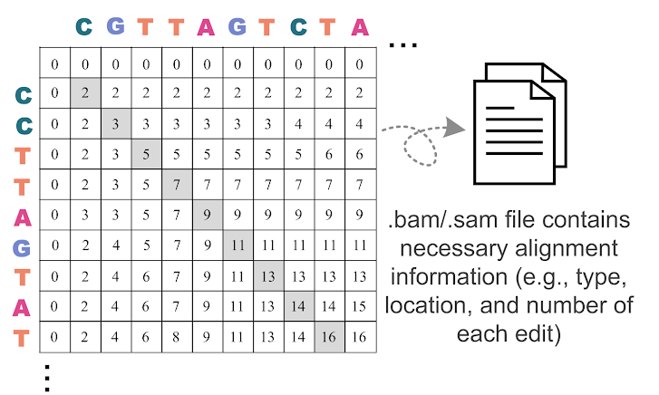
DP-based ASM
Commonly-used algorithm for ASM in genomics…
...with quadratic time and space complexity
Notes:
[CLICK] Approximate string matching is typically implemented as a dynamic programming based algorithm, which has quadratic time and space complexity. Therefore, it is desirable to find lower-complexity algorithms for ASM.

Slide 29
Bitap Algorithm
Bitap^{1,2} performs ASM with fast and simple bitwise operations
Amenable to efficient hardware acceleration
Computes the minimum edit distance between a text (e.g., reference genome) and a pattern (e.g., read) with a maximum of k errors
Step 1: Pre-processing (per pattern)
Generate a pattern bitmask (PM) for each character in the alphabet (A, C, G, T)
Each PM indicates if character exists at each position of the pattern
Step 2: Searching (Edit Distance Calculation)
Compare all characters of the text with the pattern by using:
Pattern bitmasks
Status bitvectors that hold the partial matches
Bitwise operations
[1] R. A. Baeza-Yates and G. H. Gonnet. "A New Approach to Text Searching." CACM, 1992.
[2] S. Wu and U. Manber. "Fast Text Searching: Allowing Errors." CACM, 1992.
Notes:
[CLICK] One candidate to replace DP-based algorithms for ASM is the Bitap algorithm. Bitap uses only fast and simple bitwise operations to perform ASM, making it amenable to efficient hardware acceleration.
[CLICK] Bitap tackles the problem of computing the minimum edit distance between a reference text (e.g., reference genome) and a query pattern (e.g., read) with a maximum of k errors.
The algorithm has two steps. [CLICK]
Bitap starts with a pre-processing procedure
[CLICK] where we generate one pattern bitmask for each character in the alphabet. These pattern bitmasks help us to represent the query pattern in a binary format.
Second step (searching or edit distance calculation) is the main step of the algorithm. Here, [CLICK] we examine each text character one by one, by using
[CLICK] 1) the pre-processed pattern bitmasks,
[CLICK] 2) status bitvectors which are updated at each text iteration and hold the partial match information for the text characters examined so far, and
[CLICK] 3) the simple bitwise operations.

Slide 30
Limitations of Bitap
Data Dependency Between Iterations:
Two-level data dependency forces the consecutive iterations to take place sequentially
Notes:
We find that Bitap has five limitations that hinder its applicability and efficient hardware acceleration for genome sequence analysis.
Let’s look at the first one, which is data dependency between large number of iterations

Slide 31
Bitap Algorithm (cont’d.)
Step 2: Edit Distance Calculation
For each character of the text (char):
Copy previous R bitvectors as oldR
R[0] = (oldR[0] << 1) | PM [char]
For d = 1…k:
deletion = oldR[d-1]
substitution = oldR[d-1] << 1
insertion = R[d-1] << 1
match = (oldR[d] << 1) | PM [char]
R[d] = deletion & mismatch & insertion & match
Check MSB of R[d]:
If 1, no match.
If 0, match with d many errors.
Large number of iterations
Notes:
First, Bitap iterates over each text character as the outer loop and it iterates over each possible edit distance (1 to k) as the inner loop.
Thus, when we have long error-prone reads, both of these loops need to iterate over very large numbers.

Slide 32
Bitap Algorithm (cont’d.)
Step 2: Edit Distance Calculation
For each character of the text (char):
Copy previous R bitvectors as oldR
R[0] = (oldR[0] << 1) | PM [char]
For d = 1…k:
deletion = oldR[d-1]
substitution = oldR[d-1] << 1
insertion = R[d-1] << 1
match = (oldR[d] << 1) | PM [char]
R[d] = deletion & mismatch & insertion & match
Check MSB of R[d]:
If 1, no match.
If 0, match with d many errors.
Data dependency between iterations (i.e., no parallelization)
Notes:
On top of this, There is two-level data dependency in Bitap.
[CLICK] There is an outer loop data dependency when computing deletion, substitution and match bitvectors as they require oldR bitvectors which are coming from previous text iteration.
[CLICK] Also, there is an inner loop data dependency when computing insertion bitvector as it requires R[d-1] which is coming from previous inner loop iteration.

Slide 33
Limitations of Bitap
Data Dependency Between Iterations:
Two-level data dependency forces the consecutive iterations to take place sequentially
No Support for Traceback:
Bitap does not include any support for optimal alignment identification
Notes:
Let’s look at the second limitation of Bitap, which is no support for traceback.

Slide 34
Bitap Algorithm (cont’d.)
Step 2: Edit Distance Calculation
For each character of the text (char):
Copy previous R bitvectors as oldR
R[0] = (oldR[0] << 1) | PM [char]
For d = 1…k:
deletion = oldR[d-1]
substitution = oldR[d-1] << 1
insertion = R[d-1] << 1
match = (oldR[d] << 1) | PM [char]
R[d] = deletion & mismatch & insertion & match
Check MSB of R[d]:
If 1, no match.
If 0, match with d many errors.
Does not store and process these intermediate bitvectors to find the optimal alignment (i.e., no traceback)
Notes:
Bitap generates the four intermediate bitvectors but they are not stored and processed with a traceback step to find the optimal alignment

Slide 35
Limitations of Bitap
Algorithm
Data Dependency Between Iterations:
Two-level data dependency forces the consecutive iterations to take place sequentially
No Support for Traceback:
Bitap does not include any support for optimal alignment identification
No Support for Long Reads:
Each bitvector has a length equal to the length of the pattern
Bitwise operations are performed on these bitvectors
Limited Compute Parallelism:
Text-level parallelism
Limited by the number of compute units in existing systems
Limited Memory Bandwidth:
High memory bandwidth required to read and write the computed bitvectors to memory
Hardware
Notes:
[CLICK] We find one more algorithmic limitation, which is no support for long reads. In Bitap, the query length so read length is limited by the word size of the machine running the algorithm because each bitvector has a length equal to the length of the pattern and we perform the bitwise operations on these bitvectors. Thus, the algorithm does not support long reads, whose lengths are on the order of thousands to millions of base pairs
[CLICK] These are the algorithmic limitations of the Bitap algorithm.
Even after we solve the algorithmic limitations of Bitap, we find that we cannot extract significant performance benefits with algorithmic enhancements alone.
[CLICK] 4) For example, while Bitap iterates over each character of the input text sequentially, we can enable text-level parallelism to improve its performance. However, the achievable level of parallelism is limited by the number of compute units in existing systems.
5) We would expect that a GPU, which has thousands of compute units, can overcome the limited compute parallelism issues that CPUs experience. [CLICK] However, we find that a GPU implementation of the Bitap algorithm suffers from the limited amount of memory bandwidth available for each GPU thread.
[CLICK] And these are the HW-related limitations.
In order to overcome these limitations and design an efficient accelerator, we find that we need to both (1) modify and extend the Bitap algorithm and (2) develop specialized hardware that can exploit the new opportunities that our algorithmic modifications provide.

Slide 36
GenASM: ASM Framework for GSA
Approximate string matching (ASM) acceleration framework based on the Bitap algorithm
First ASM acceleration framework for genome sequence analysis
We overcome the five limitations that hinder Bitap’s use in genome sequence analysis:
Modified and extended ASM algorithm
Highly-parallel Bitap with long read support
Novel bitvector-based algorithm to perform traceback
Specialized, low-power and area-efficient hardware for both modified Bitap and novel traceback algorithms
SW
HW
Notes:
To this end, we propose GenASM, an ASM acceleration framework for genome sequence analysis.
[CLICK] To our knowledge, GenASM is the first ASM acceleration framework for GSA and it is also first that enhances and accelerates Bitap. [CLICK] We make significant modifications to Bitap in order to overcome those five limitations.
[CLICK] First, we modify the Bitap algorithm, by extending it to support long reads and by eliminating loop-carried data dependencies to enable parallelization.
[CLICK] Second, we develop a novel Bitap-compatible algorithm for traceback, which uses information collected during ASM about the different types of errors to identify the optimal alignment of reads.
[CLICK] these cover the algorithmic contributions of GenASM
[CLICK] And third, we co-design specialized, low-power and area-efficient hardware for both algorithms.
[CLICK] and this covers the hardware-level contributions of GenASM

Slide 37
GenASM Hardware Design
Main Memory
GenASM-DC
GenASM-DC
GenASM-TB
GenASM-DC
Accelerator
GenASM-TB
GenASM-DC
Accelerator
DC-SRAM
DC-SRAM
TB-SRAM₁
TB-SRAM₁
GenASM-TB
Accelerator
GenASM-TB
Accelerator
TB-SRAM₂
Host CPU
TB-SRAM₂
.
.
.
TB-SRAM_{n}
TB-SRAM_{n}
GenASM-DC:
generates bitvectors
and performs edit
Distance Calculation
GenASM-TB: performs TraceBack and assembles the optimal alignment
Notes:
Let’s look at the HW design of GenASM.
Our co-designed hardware consists of two components:
[CLICK] (1) GenASM-DC, which provides hardware support to efficiently execute our GenASM-DC algorithm to perform distance calculation; and
[CLICK] (2) GenASM-TB, which provides hardware support to efficiently execute our novel GenASM-TB algorithm to find the optimal alignment.
GenASM also has two types of SRAM buffers: [CLICK] DC-SRAM and [CLICK] TB-SRAMs
Let’s look at the high-level overview of GenASM

Slide 38
GenASM Hardware Design
Main Memory
GenASM-DC
GenASM-DC
GenASM-TB
GenASM-DC
Accelerator
GenASM-TB
GenASM-DC
Accelerator
DC-SRAM
DC-SRAM
2
2
reference text
& query pattern
7
reference text
& query pattern
sub-text &
sub-pattern
Find the
traceback output
3
sub-text &
sub-pattern
3
TB-SRAM₁
TB-SRAM₁
GenASM-TB
Accelerator
GenASM-TB
Accelerator
6
5
6
5
TB-SRAM₂
Host CPU
TB-SRAM₂
Write
bitvectors
Write
bitvectors
Read
bitvectors
.
.
.
Read
bitvectors
1
1
TB-SRAM_{n}
reference & query locations
TB-SRAM_{n}
reference & query locations
Generate
bitvectors
Generate
bitvectors
4
4
GenASM-DC:
generates bitvectors
and performs edit
Distance Calculation
GenASM-TB: performs TraceBack and assembles the optimal alignment
Notes:
[CLICK] GenASM execution starts when the host CPU issues a task to GenASM with the reference and the query sequences’ locations.
[CLICK] GenASM-DC reads the corresponding reference text region and the query pattern from the memory, and then writes these to its dedicated SRAM, DC-SRAM.
In order to decrease the memory footprint of the algorithm, it follows a divide-and-conquer approach, where we divide the text and pattern into overlapping windows and perform the traceback computation for each window. After all of the windows’ partial traceback outputs are generated, we merge them to find the complete traceback output.
[CLICK] After that, GenASM-DC divides the reference text and query pattern into multiple overlapping windows, and
[CLICK] for each sub-text and sub-pattern, GenASM-DC searches for the sub-pattern within the sub-text and generates the bitvectors.
[CLICK] GenASM-DC writes the generated bitvectors to TB-SRAMs. Once GenASM-DC completes its search for the current window,
[CLICK] GenASM-TB starts reading the stored bitvectors from TB-SRAMs and
[CLICK] generates the window’s traceback output.
Once GenASM-TB generates this output, GenASM computes the next window and repeats Steps 3–7 until all windows are completed.

Slide 39
GenASM Hardware Design
Main Memory
GenASM-DC
GenASM-DC
GenASM-TB
GenASM-DC
Accelerator
GenASM-TB
GenASM-DC
Accelerator
DC-SRAM
DC-SRAM
2
reference text
& query pattern
7
sub-text &
sub-pattern
Find the
traceback output
3
TB-SRAM₁
TB-SRAM₁
GenASM-TB
Accelerator
GenASM-TB
Accelerator
5
TB-SRAM₂
6
Host CPU
TB-SRAM₂
Write
bitvectors
.
.
.
Read
bitvectors
1
TB-SRAM_{n}
reference & query locations
TB-SRAM_{n}
Generate
bitvectors
4
GenASM-DC:
generates bitvectors
and performs edit
Distance Calculation
GenASM-TB: performs TraceBack and assembles the optimal alignment
Our specialized compute units and on-chip SRAMs help us to:
Match the rate of computation with memory capacity and bandwidth
Achieve high performance and power efficiency
Scale linearly in performance with the number of parallel compute units that we add to the system
Notes:
[CLICK] Our specialized compute units and on-chip SRAMs helps us to:
[CLICK] (1) Match the rate of computation with memory capacity and bandwidth
[CLICK] (2) Achieve high performance and power efficiency
[CLICK] (3) Scale linearly in performance with the number of parallel compute units that we add to the system

Slide 40
GenASM-DC: Hardware Design
Linear cyclic systolic array-based accelerator
Designed to maximize parallelism and minimize memory bandwidth and memory footprint
Processing Block (PB)
Processing Core (PC)
Notes:
Let's look at GenASM-DC's hardware design.
[CLICK] We implement GenASM-DC as a linear cyclic systolic array based accelerator, using small and very simple logic components.
[CLICK] This design helps us to maximize parallelism and minimize memory BW and footprint.
[CLICK] Processing Core is the basic compute component which computes the intermediate bitvectors
[CLICK] and when we add the flip-flop-based storage logic around Processing Core, we define a Processing Element (PE)
[CLICK] Multiple PEs are concatenated to define a Processing Block
[CLICK] We also have DC-SRAM, which stores the reference text, the pattern bitmasks for the query read, and the intermediate data generated from PEs, and we also have
[CLICK] TB-SRAMs, which store the intermediate bitvectors generated by each PE of GenASM-DC for later use by GenASM-TB.

Slide 41
GenASM-TB: Hardware Design
1
1
Last CIGAR
1
2
.
.
64
Last CIGAR
1
2
.
.
64
64
64
match
match
2
2
CIGAR string
CIGAR string
Bitwise Comparisons
64
Bitwise Comparisons
64
insertion
insertion
CIGAR
out
192
CIGAR
out
192
deletion
64
deletion
64
3
3
Next Rd Addr Compute
subs
Next Rd Addr Compute
64
subs
64
<<
<<
1.5KB
TB-SRAM₁
1.5KB
TB-SRAM₂
GenASM-TB
1.5KB
TB-SRAM₆₄
to main
memory
Very simple logic:
❶Reads the bitvectors from one of the TB-SRAMs using the computed address
❷Performs the required bitwise comparisons to find the traceback output for the current position
❸Computes the next TB-SRAM address to read the new set of bitvectors
1
2
3
Notes:
[CLICK] We implement GenASM-TB hardware using very simple logic, which
[CLICK] 1) reads the bitvectors from one of the TB-SRAMs using the computed address,
[CLICK] 2) performs the required bitwise comparisons to find the traceback output for the current position, and
[CLICK] 3) computes the next TB-SRAM address to read the new set of bitvectors.
After GenASM-TB finds the complete traceback output (which is also called CIGAR string), [CLICK] it writes the output to main memory and completes its execution.

Slide 42
Use Cases of GenASM
Read Alignment Step of Read Mapping
Find the optimal alignment of how reads map to candidate reference regions
Pre-Alignment Filtering for Short Reads
Quickly identify and filter out the unlikely candidate reference regions for each read
Edit Distance Calculation
Measure the similarity or distance between two sequences
We also discuss other possible use cases of GenASM in our paper:
Read-to-read overlap finding, hash-table based indexing, whole genome alignment, generic text search
Notes:
We demonstrate the efficiency and flexibility of the GenASM acceleration framework by describing three use cases of approximate string matching in genome sequence analysis:
[CLICK] (1) read alignment step of short and long read mapping,
[CLICK] (2) pre-alignment filtering for short reads,
[CLICK] (3) edit distance calculation between any two arbitrary-length sequences, which is one of the fundamental operations in genomics that measures the similarity or distance btw two sequences
[CLICK] We believe the GenASM framework can be useful for many other use cases, and we discuss some of them briefly in our paper, including generic text search

Slide 43
Evaluation Methodology
We evaluate GenASM using:
Synthesized SystemVerilog models of the GenASM-DC and GenASM-TB accelerator datapaths
Detailed simulation-based performance modeling
16GB HMC-like 3D-stacked DRAM architecture
32 vaults
256GB/s of internal bandwidth, clock frequency of 1.25GHz
In order to achieve high parallelism and low power-consumption
Within each vault, the logic layer contains a GenASM-DC accelerator, its associated DC-SRAM, a GenASM-TB accelerator, and TB-SRAMs.
Notes:
Let’s look at our evaluation of the GenASM design and framework.
[CLICK] We evaluate GenASM using a combination of
(1) synthesis of our DC and TB accelerator datapaths, and
(2) detailed simulation-based performance modeling
[CLICK] We evaluate a 16GB HMC-like 3D-stacked DRAM arch, with 32 vaults. Our accelerators can be ported anywhere in the system, but in order to achieve high parallelism and low power-consumption, we place GenASM-DC and GenASM-TB in the logic layer of 3D-stacked memory. As I will show next, our hardware is highly efficient in terms of both area and power, so they are within the budget limits of the logic layer.

Slide 44
Evaluation Methodology (cont’d.)
 | SW Baselines | HW Baselines
Read Alignment | Minimap2¹ BWA-MEM² | GACT (Darwin)³ SillaX (GenAx)⁴
Pre-Alignment Filtering | – | Shouji⁵
Edit Distance Calculation | Edlib⁶ | ASAP⁷
[1] H. Li. "Minimap2: Pairwise Alignment for Nucleotide Sequences." In Bioinformatics, 2018.
[2] H. Li. "Aligning sequence reads, clone sequences and assembly contigs with BWA-MEM." In arXiv, 2013.
[3] Y. Turakhia et al. "Darwin: A genomics co-processor provides up to 15,000 x acceleration on long read assembly." In ASPLOS, 2018.
[4] D. Fujiki et al. "GenAx: A genome sequencing accelerator." In ISCA, 2018.
[5] M. Alser. "Shouji: A fast and efficient pre-alignment filter for sequence alignment." In Bioinformatics, 2019.
[6] M. Šošić et al. "Edlib: A C/C++ library for fast, exact sequence alignment using edit distance." In Bioinformatics, 2017.
[7] S.S. Banerjee et al. ”ASAP: Accelerated short-read alignment on programmable hardware." In TC, 2018.
Notes:
[CLICK] For the use cases we evaluate, we compare GenASM with state-of-the-art SW and HW baselines.

Slide 45
Evaluation Methodology (cont’d.)
For Use Case 1: Read Alignment, we compare GenASM with:
Minimap2 and BWA-MEM (state-of-the-art SW)
Running on Intel® Xeon® Gold 6126 CPU (12-core) operating @2.60GHz with 64GB DDR4 memory
Using two simulated datasets:
Long ONT and PacBio reads: 10Kbp reads, 10-15% error rate
Short Illumina reads: 100-250bp reads, 5% error rate
GACT of Darwin and SillaX of GenAx (state-of-the-art HW)
Open-source RTL for GACT
Data reported by the original work for SillaX
GACT is best for long reads, SillaX is best for short reads
Notes:
I won’t go into details, but you can refer to our paper for more details or I am happy to answer your questions at the end.

Slide 46
Evaluation Methodology (cont’d.)
For Use Case 2: Pre-Alignment Filtering, we compare GenASM with:
Shouji (state-of-the-art HW – FPGA-based filter)
Using two datasets provided as test cases:
100bp reference-read pairs with an edit distance threshold of 5
250bp reference-read pairs with an edit distance threshold of 15
For Use Case 3: Edit Distance Calculation, we compare GenASM with:
Edlib (state-of-the-art SW)
Using two 100Kbp and 1Mbp sequences with similarity ranging between 60%-99%
ASAP (state-of-the-art HW – FPGA-based accelerator)
Using data reported by the original work

Slide 47
Key Results – Area and Power
Based on our synthesis of GenASM-DC and GenASM-TB accelerator datapaths using the Synopsys Design Compiler with a 28nm process:
Both GenASM-DC and GenASM-TB operate @ 1GHz
Total (1 vault): 0.334 mm² 0.101 W
Total (32 vaults): 10.69 mm² 3.23 W
% of a Xeon CPU core: 1% 1%
Notes:
[CLICK] We synthesize our DC and TB accelerator datapaths with a typical 28nm process:
[CLICK] Both accelerators operates at 1GHz.
[CLICK] We find that for 32 GenASM accelerator (one for each HMC vault), total area overhead is ten point sixty nine millimeter square and total power consumption is three point twenty-three watts.
We observe that both area and power consumption of GenASM (at 1 vault) is around 1% of the area and power consumption of a single Xeon CPU core.

Slide 48
Key Results – Area and Power
Based on our synthesis of GenASM-DC and GenASM-TB accelerator datapaths using the Synopsys Design Compiler with a 28nm LP process:
Both GenASM-DC and GenASM-TB operate @ 1GHz
GenASM has low area and power overheads
Notes:
Thus, GenASM has low area and power overheads.

Slide 49
Key Results – Use Case 1
Read Alignment Step of Read Mapping
Find the optimal alignment of how reads map to candidate reference regions
Pre-Alignment Filtering for Short Reads
Quickly identify and filter out the unlikely candidate reference regions for each read
Edit Distance Calculation
Measure the similarity or distance between two sequences
Notes:
Let’s look at our results for the first use case: read alignment

Slide 50
Key Results – Use Case 1 (Long Reads)
116×
648×
GenASM achieves 648× and 116× speedup over
12-thread runs of BWA-MEM and Minimap2,
while reducing power consumption by 34× and 37×
SW
Notes:
[CLICK] As software baselines, we compare GenASM with BWA-MEM (which is shown with red bars) and Minimap2 (which is shown with purple bars). Both are commonly used, state-of-the-art read mappers.
[CLICK] We find that GenASM achieves [CLICK] six hundred and forty eight times speedup over 12-thread run of BWA-MEM and [CLICK] a hundred and sixteen times speedup over 12-thread run of Minimap2 (SW), [CLICK] while reducing power consumption by thirty four times and thirty seven times.

Slide 51
Key Results – Use Case 1 (Long Reads)
3.9×
HW
GenASM provides 3.9× better throughput,
6.6× the throughput per unit area, and
10.5× the throughput per unit power,
compared to GACT of Darwin
Notes:
[CLICK] Compared to GACT of Darwin, which is a state-of-the-art long read alignment accelerator, [CLICK] GenASM provides 3.9 times better throughput, [CLICK] 6.6 times better throughput per unit area, and 10.5 times better throughput per unit power.

Slide 52
Key Results – Use Case 1 (Short Reads)
158×
111×
SW
GenASM achieves 111× and 158× speedup over
12-thread runs of BWA-MEM and Minimap2,
while reducing power consumption by 33× and 31×
GenASM provides 1.9× better throughput and
uses 63% less logic area and 82% less logic power,
compared to SillaX of GenAx
HW
Notes:
[CLICK] For short reads, compared to same SW baselines, [CLICK] [CLICK] [CLICK] GenASM provides significant speedup and reduction in power consumption, similar to long reads.
[CLICK] Compared to SillaX of GenAx, which is a state-of-the-art short read alignment accelerator, GenASM provides 1.9 times better throughput, while using 63% less logic area and 82% less logic power.

Slide 53
Key Results – Use Case 2
Read Alignment Step of Read Mapping
Find the optimal alignment of how reads map to candidate reference regions
Pre-Alignment Filtering for Short Reads
Quickly identify and filter out the unlikely candidate reference regions for each read
Edit Distance Calculation
Measure the similarity or distance between two sequences
Notes:
Let’s briefly look at our results for our second use case: pre-alignment filtering

Slide 54
Key Results – Use Case 2
Compared to Shouji:
3.7× speedup
1.7× less power consumption
False accept rate of 0.02% for GenASM vs. 4% for Shouji
False reject rate of 0% for both GenASM and Shouji
GenASM is more efficient in terms of
both speed and power consumption,
while significantly improving the accuracy
of pre-alignment filtering
HW
Notes:
[CLICK] Here is the key takeaway:
Compared to Shouji, which is a state-of-the-art FPGA-based filter, GenASM is more efficient in terms of both speed and power consumption, while significantly improving the accuracy of pre-alignment filtering

Slide 55
Key Results – Use Case 3
Read Alignment Step of Read Mapping
Find the optimal alignment of how reads map to candidate reference regions
Pre-Alignment Filtering for Short Reads
Quickly identify and filter out the unlikely candidate reference regions for each read
Edit Distance Calculation
Measure the similarity or distance between two sequences
Notes:
Similarly, let’s briefly look at our results for the third use case: edit distance calculation

Slide 56
Key Results – Use Case 3
12501×
627×
146×
1458×
GenASM provides 146 – 1458× and 627 – 12501× speedup,
while reducing power consumption by 548× and 582×
for 100Kbp and 1Mbp sequences, respectively, compared to Edlib
SW
GenASM provides 9.3 – 400× speedup over ASAP,
while consuming 67× less power
HW
Notes:
Here are the key takeaways:
Compared to the SW baseline, Edlib, GenASM provides 2 to 4 orders of magnitude speedup, while reducing power consumption by 2 orders of magnitude.
And compared to the HW baseline, ASAP, GenASM provides 9.3 to 400 times speedup, while consuming 67 times less power

Slide 57
Additional Details in the Paper
Details of the GenASM-DC and GenASM-TB algorithms
Big-O analysis of the algorithms
Detailed explanation of evaluated use cases
Evaluation methodology details (datasets, baselines, performance model)
Additional results for the three evaluated use cases
Sources of improvements in GenASM (algorithm-level, hardware-level, technology-level)
Discussion of four other potential use cases of GenASM
Notes:
Before I summarize GenASM, here is the list of additional details that you can find in our paper.

Slide 58
Summary of GenASM
Problem:
Genome sequence analysis is bottlenecked by the computational power and memory bandwidth limitations of existing systems
This bottleneck is particularly an issue for approximate string matching
Key Contributions:
GenASM: An approximate string matching (ASM) acceleration framework to accelerate multiple steps of genome sequence analysis
First to enhance and accelerate Bitap for ASM with genomic sequences
Co-design of our modified scalable and memory-efficient algorithms with low-power and area-efficient hardware accelerators
Evaluation of three different use cases: read alignment, pre-alignment filtering, edit distance calculation
Key Results: GenASM is significantly more efficient for all the three use cases (in terms of throughput and throughput per unit power) than state-of-the-art software and hardware baselines
Notes:
[CLICK] To summarize, in this work, we focus on approximate string matching because it is one of the main bottlenecks of genome sequence analysis.
[CLICK] We propose GenASM, an approximate string matching (ASM) acceleration framework to accelerate multiple steps of genome sequence analysis
[CLICK] GenASM is the first work that enhances and accelerates Bitap for ASM with genomic sequences
[CLICK] In GenASM, we co-design our modified scalable and memory-efficient algorithms with low-power and area-efficient hardware accelerators
[CLICK] We evaluate three different use cases and
[CLICK] we show that GenASM is significantly more efficient for all the three use cases (in terms of throughput and throughput per unit power) than state-of-the-art software and hardware baselines

Slide 59
Outline
Bottleneck analysis of long read assembly
[Briefings in Bioinformatics, 2018]
GenASM: Approximate string matching framework
for genome sequence analysis
[MICRO 2020]
BitMAc: FPGA-based near-memory acceleration of bitvector-based sequence alignment
[Ongoing]
GenGraph: Hardware acceleration framework
for sequence-to-graph mapping
[Ongoing]
Notes:
Next I will talk about 2 ongoing works, where we build upon GenASM.
First one, BitMAC is where we propose the FPGA-based near-memory acceleration …

Slide 60
BitMAc: FPGA-based GenASM
Goal: Implement and map GenASM-DC and GenASM-TB to an FPGA with HBM2 and demonstrate end-to-end application acceleration
Key Idea: HBM2 offers high bandwidth and FPGA resources offer high parallelism by instantiating multiple copies of GenASM accelerators
Key Findings:
Due to high amount of data needs to be saved for TB, we are bottlenecked by the amount of on-chip memory we have
We cannot saturate the high bandwidth that multiple HBM2 stacks that are on package provide
Thus, we need
Algorithm-level modifications to decrease the amount of data that need to be written, and
New FPGA chips, which has a higher amount of on-chip memory capacity and bandwidth
Notes:
By implementing and mapping …

Slide 61
Outline
Bottleneck analysis of long read assembly
[Briefings in Bioinformatics, 2018]
GenASM: Approximate string matching framework
for genome sequence analysis
[MICRO 2020]
BitMAc: FPGA-based near-memory acceleration of bitvector-based sequence alignment
[Ongoing]
GenGraph: Hardware acceleration framework
for sequence-to-graph mapping
[Ongoing]
Notes:
In our second ongoing work, we explore how we can utilize this BW by also including another step of read mapping pipeline to our design. But also, here in this work, we explore a similar but different genomics problem: sequence-to-graph mapping.

Slide 62
Recall: Read Mapping Pipeline
Reference genome
Indexing
(Pre-processing step to generate index of reference)
reference bias
Hash-table based index
Reads
Seeding
(Query the index)
Potential mapping
locations
Reference
segment
Pre-Alignment Filtering
(Filter out dissimilar sequences)
Query read
Remaining potential mapping locations
Read Alignment
(Perform distance/score calculation & traceback)
Optimal alignment
Notes:
As you recall, in read mapping, we start with a linear sequence of a single reference genome. However, this linear reference genome does not represent the genetic variations exist in a population and cause reference bias when performing read mapping with respect to it.

Slide 63
Genome Graphs
Genome graphs:
Include the reference genome together with genetic variations
Provide a compact representation
Enable us to move away from aligning with single reference genome (reference bias) and toward using the sequence diversity
Reference #1: ACGTACGT
ACGTACGT
Notes:
So, the genomics community has recently started gaining interest in genome graphs, which include …

Slide 64
Genome Graphs
Genome graphs:
Include the reference genome together with genetic variations
Provide a compact representation
Enable us to move away from aligning with single reference genome (reference bias) and toward using the sequence diversity
Reference #1: ACGTACGT
Reference #2: ACGGACGT
ACGTACGT

Slide 65
Genome Graphs
Genome graphs:
Include the reference genome together with genetic variations
Provide a compact representation
Enable us to move away from aligning with single reference genome (reference bias) and toward using the sequence diversity
T
Reference #1: ACGTACGT
Reference #2: ACGGACGT
ACG
ACGT
G

Slide 66
Genome Graphs
Genome graphs:
Include the reference genome together with genetic variations
Provide a compact representation
Enable us to move away from aligning with single reference genome (reference bias) and toward using the sequence diversity
T
Reference #1: ACGTACGT
Reference #2: ACGGACGT
Reference #3: ACGTTACGT
ACG
ACGT
G

Slide 67
Genome Graphs
Genome graphs:
Include the reference genome together with genetic variations
Provide a compact representation
Enable us to move away from aligning with single reference genome (reference bias) and toward using the sequence diversity
T
Reference #1: ACGTACGT
Reference #2: ACGGACGT
Reference #3: ACGTTACGT
ACG
ACGT
T
G

Slide 68
Genome Graphs
Genome graphs:
Include the reference genome together with genetic variations
Provide a compact representation
Enable us to move away from aligning with single reference genome (reference bias) and toward using the sequence diversity
T
Reference #1: ACGTACGT
Reference #2: ACGGACGT
Reference #3: ACGTTACGT
Reference #4: ACGACGT
ACG
ACGT
T
G

Slide 69
Genome Graphs
Genome graphs:
Include the reference genome together with genetic variations
Provide a compact representation
Enable us to move away from aligning with single reference genome (reference bias) and toward using the sequence diversity
T
Reference #1: ACGTACGT
Reference #2: ACGGACGT
Reference #3: ACGTTACGT
Reference #4: ACGACGT
ACG
ACGT
T
G

Slide 70
GenGraph
Motivation:
Traditional read mapping causes reference bias
Aligning sequences to graphs is a newer field and practical tools only start to emerge
HW acceleration of sequence-to-graph mapping: important but unexplored research problem
Goal: Design an accelerator framework for sequence-to-graph mapping, which provides high performance and high accuracy
Our Approach:
BitAlign: Modified GenASM algorithms and HW accelerators for sequence-to-graph alignment
MinSeed: The first minimizer-based seeding hardware
Notes:
So, [CLICK] since traditional read mapping causes reference bias, [CLICK] aligning sequences to graphs emerges a newer field and practical tools only start to emerge, where most of the existing tools are specialized for one purpose. [CLICK] Thus, HW acceleration of sequence-to-graph mapping is an important but unexplored research problem.
[CLICK] Thus, in GenGraph, our goal is to design an accelerator framework for sequence-to-graph mapping, which provides high performance and high accuracy. It is important to be comprehensive in terms of genome graph types and applications.
[CLICK] To this end, [CLICK] we first modify … and [CLICK] we also propose the first …

Slide 71
Overview of GenGraph
Main Memory (genome-based reference & index)
Min-SRAM
Seed-SRAM
DC-SRAM
BitAlign-DC Accelerator
MinSeed Accelerator
TB-SRAMs & Hop Queue Registers
query
read
Host CPU
BitAlign-TB Accelerator
MinSeed:
performs minimizer-based seeding
BitAlign:
performs bitvector-based
sequence-to-graph alignment
Notes:
***
we are still finishing the design and evaluation, and hope to have more information to share in the coming months

Slide 72
Outline
Bottleneck analysis of long read assembly
[Briefings in Bioinformatics, 2018]
GenASM: Approximate string matching framework
for genome sequence analysis
[MICRO 2020]
BitMAc: FPGA-based near-memory acceleration of bitvector-based sequence alignment
[Ongoing]
GenGraph: Hardware acceleration framework
for sequence-to-graph mapping
[Ongoing]
Notes:
This covers the works that I want to present today. To conclude,

Slide 73
Conclusion
Rapid genome sequence analysis is bottlenecked
by the computational power and memory bandwidth limitations of existing systems,
as many of the steps in genome sequence analysis must process a large amount of data
Notes:
We observe that …

Slide 74
Conclusion (cont’d.)
Genome sequence analysis can be accelarated
by co-designing fast and efficient algorithms
along with scalable and energy-efficient customized hardware accelerators
for the key bottleneck steps of the pipeline
Notes:
But genome sequence analysis can be accelerated by …

Slide 75
Conclusion (cont’d.)
Bottleneck analysis of long read assembly
[Briefings in Bioinformatics, 2018]
GenASM: Approximate string matching framework
for genome sequence analysis
[MICRO 2020]
BitMAc: FPGA-based near-memory acceleration of bitvector-based sequence alignment
[Ongoing]
GenGraph: Hardware acceleration framework
for sequence-to-graph mapping
[Ongoing]
Notes:
To this end, in my first work, we aimed to understand where the current tools and algorithms do not perform well in order to develop better tools and algorithms, and to understand the limitations of existing hardware systems when running these tools and algorithms in order to design efficient customized accelerators. For this work, our key takeaway is we need memory-efficient, low-power, and scalable designs for genomics in order to exploit the advantages that new sequencing technologies provide, such as near sequencing device analysis for real-time analysis, portability to perform GS & GSA anywhere in the world (even remote places) etc.
To this end, in my second work, we propose GenASM, HW/Alg co-design to accelerate one of the key bottlenecks of GSA: ASM. In GenASM, we co-design our modified scalable and memory-efficient algorithms with low-power and area-efficient hardware accelerators. We evaluate three different use cases and we show that GenASM is significantly more efficient for all the three use cases than state-of-the-art software and hardware baselines
My third work is the FPGA mapping of our GenASM accelerators, where we implement and map GenASM-DC and GenASM-TB to an FPGA with HBM2 and demonstrate end-to-end application acceleration. We revealed that Due to high amount of data needs to be saved for TB, we are bottlenecked by the amount of on-chip memory we have, and we cannot saturate the high bandwidth that multiple HBM2 stacks that are on package provide.
Thus, in my fourth work, in order to exploit the high BW that HBM2 provides, we propose the first minimizer-based seeding accelerator, which performs the memory-access heavy step of read mapping. In addition, instead of traditional read mapping, GenGraph focuses on graph mapping problem, which is a newer genomics problem, to get rid of the reference bias and provide a more comprehensive and accurate solution for the one of the key GSA steps, read mapping.

Slide 76
Other Publications in CMU
FPGA-based Near-Memory Acceleration of Modern Data-Intensive Applications (IEEE Micro, 2021)
Gagandeep Singh, Mohammed Alser, Damla Senol Cali, Dionysios Diamantopoulos, Juan Gomez-Luna, Henk Corporaal, and Onur Mutlu.
Accelerating Genome Analysis: A Primer on an Ongoing Journey (IEEE Micro, 2020)
Mohammed Alser, Zulal Bingol, Damla Senol Cali, Jeremie S. Kim, Saugata Ghose, Can Alkan, and Onur Mutlu.
Apollo: A Sequencing-Technology-Independent, Scalable, and Accurate Assembly Polishing Algorithm (Bioinformatics, 2020)
Can Firtina, Jeremie S. Kim, Mohammed Alser, Damla Senol Cali, A. Ercument Cicek, Can Alkan, and Onur Mutlu.
Demystifying Workload–DRAM Interactions: An Experimental Study (ACM SIGMETRICS, 2019)
Saugata Ghose, Tianshi Li, Nastaran Hajinazar, Damla Senol Cali, and Onur Mutlu.
GRIM-Filter: Fast Seed Location Filtering in DNA Read Mapping Using Processing-in-Memory Technologies (BMC Genomics, 2018)
Jeremie S. Kim, Damla Senol Cali, Hongyi Xin, Donghyuk Lee, Saugata Ghose, Mohammed Alser, Hasan Hassan, Oguz Ergin, Can Alkan, and Onur Mutlu.
Notes:
Besides these works, …

Slide 77
Accelerating Genome Sequence Analysis via Efficient Hardware/Algorithm Co-Design
Damla Senol Cali
Carnegie Mellon University
(dsenol@andrew.cmu.edu)
June 24, 2021
Job Talk
Notes:
Thank you so much for listening! I look forward to providing more details regarding the ongoing projects we have in the upcoming months.

